Slide 1
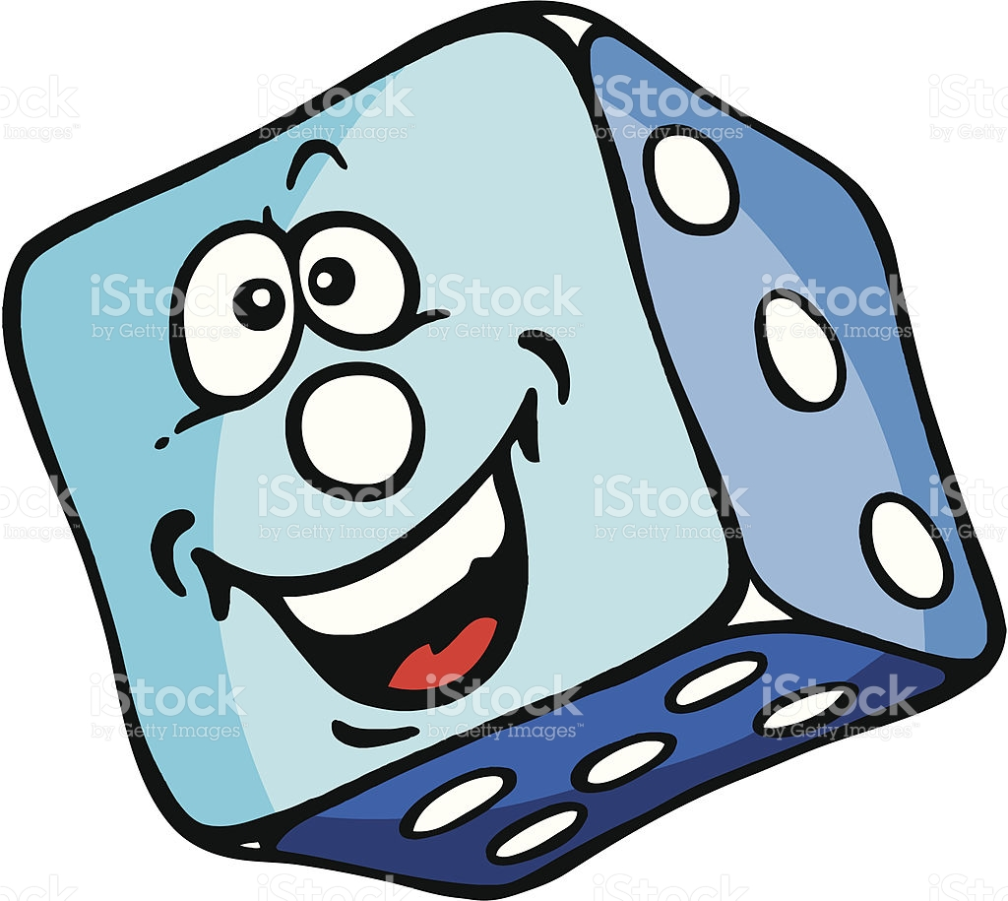
Simple „Dice“ Games
www.math-games.eu

Slide 2
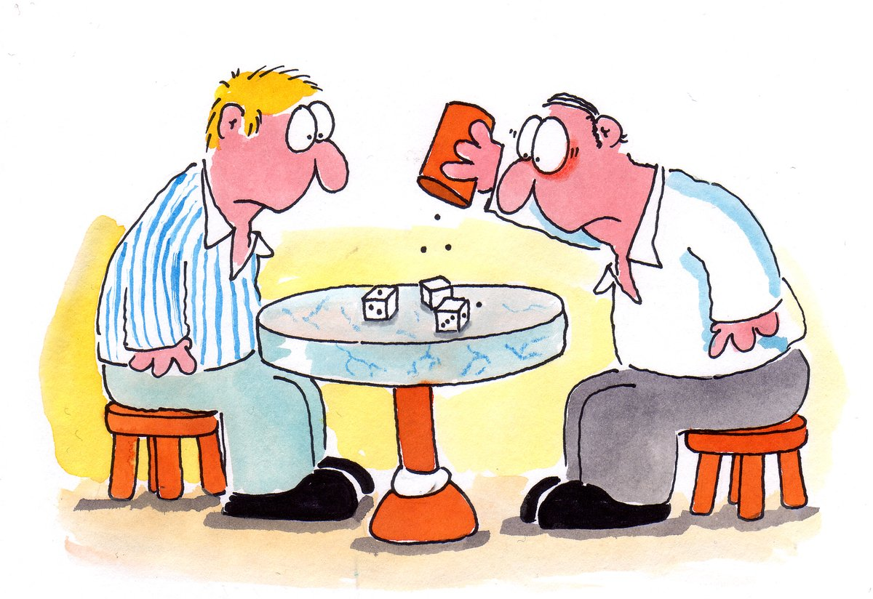

Slide 3
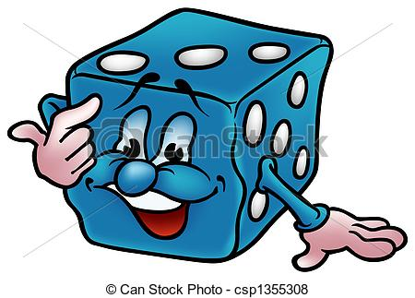
Objectives

Slide 4
Objectives
The participants learn all about a cube.

Slide 5
Objectives
The participants learn all about a cube.
The participants learn how a cube becomes a dice with specific qualities and the historical background.

Slide 6
Objectives
The participants learn all about a cube.
The participants learn how a cube becomes a dice with specific qualities and the historical background.
The participants learn to construct a cube from a net of a cube (not today ☺).

Slide 7
Objectives
The participants learn all about a cube.
The participants learn how a cube becomes a dice with specific qualities and the historical background.
The participants learn to construct a cube from a net of a cube (not today ☺).
The participants learn how a cube is transformed into a gambling dice.

Slide 8
Objectives
The participants learn all about a cube
The participants learn how a cube becomes a dice with specific qualities and the historical background
The participants learn to construct a cube from a net of a cube (not today ☺)
The participants learn how a cube is transformed into a gambling dice
etc.

Slide 9
Tools, Materials and Organisation

Slide 10
Tools, Materials and Organisation
Groups of 2 to 5 are sitting around a table.

Slide 11
Tools, Materials and Organisation
Groups of 2 to 5 are sitting around a table.
On each table are dice, notepaper, a pencil and if you want a shaker.

Slide 12
Tools, Materials and Organisation
Groups of 2 to 5 are sitting around a table.
On each table are dice, notepaper, a pencil and if you want a shaker.
For the construction of a cube you need paper, scissors and a glue (not today ☺).

Slide 13
Prerequisites

Slide 14
Prerequisites
The participants know the numbers from 1-20 (lower level), 1-100 (higher level).

Slide 15
Prerequisites
The participants know the numbers from 1-20 (lower level), 1-100 (higher level).
The participants are able to use Addition and Substraction.

Slide 16
Prerequisites
The participants know the numbers from 1-20 (lower level), 1-100 (higher level).
The participants are able to use Addition and Substraction.
The target groups are pupils and adults from 10 to 99.

Slide 17
Description of the first part
of the lesson, 20 minutes

Slide 18
Description of the first part
of the lesson, 20 minutes
Make groups from 2 to 5

Slide 19
Description of the first part
of the lesson, 20 minutes
Make groups from 2 to 5
Choose two from the compendium of 10 dice games

Slide 20
Description of the first part
of the lesson, 20 minutes
Make groups from 2 to 5
Choose two from the compendium of 10 dice games
Play the game several times and note the winner

Slide 21
Description of the first part
of the lesson, 20 minutes
Make groups from 2 to 5
Choose two from the compendium of 10 dice games
Play the game several times and note the winner
Which game is the most funny or exciting game?

Slide 22
Description of the first part
of the lesson, 20 minutes
Make groups from 2 to 5
Choose two from the compendium of 10 dice games
Play the game several times and note the winner
Which game is the most funny or exciting game?
etc.

Slide 23
Description of the second part
of the lesson, 25 minutes

Slide 24
Description of the second part
of the lesson, 25 minutes
The participants construct their own cube or dice from a net of a cube

Slide 25
Description of the second part
of the lesson, 25 minutes
The participants construct their own cube or dice from a net of a cube
Each participant gets one worksheet, ruler and pencil, scissors an glue

Slide 26
Description of the second part
of the lesson, 25 minutes
The participants construct their own cube or dice from a net of a cube
Each participant gets one worksheet, ruler and pencil, scissors an glue
Follow the instruction of the worksheet

Slide 27
1. Swing (page 39) 2. Heaven and Hell (page 42)
Dice Games

Slide 28
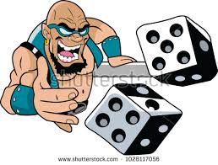

Slide 30
...If you want more www.math-games.eu
Thank you

